Slide 1
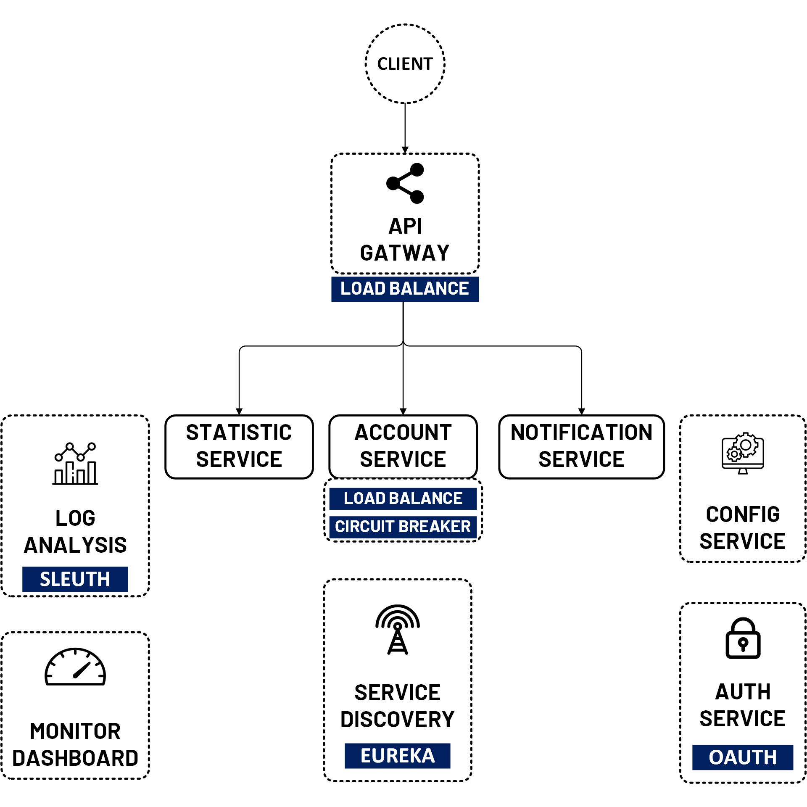

OAuth 2 Security Password Flow
www.jmaster.io/course/microservices-with-spring-cloud

Slide 2
Password Flow
Client application exchange a user's credentials for an access token.
This flow quite limiting for things like multifactor authentication or delegated accounts
Not recommended in Practice

Slide 3
